Slide 1
Evidence-Based Decision Making
In Healthcare
Systematic Reviews and Meta-Analysis
Jay K. Varma, MD
https://drjayvarma.com
Dr Jay K Varma | https://drjayvarma.com
Notes:
1

Slide 2
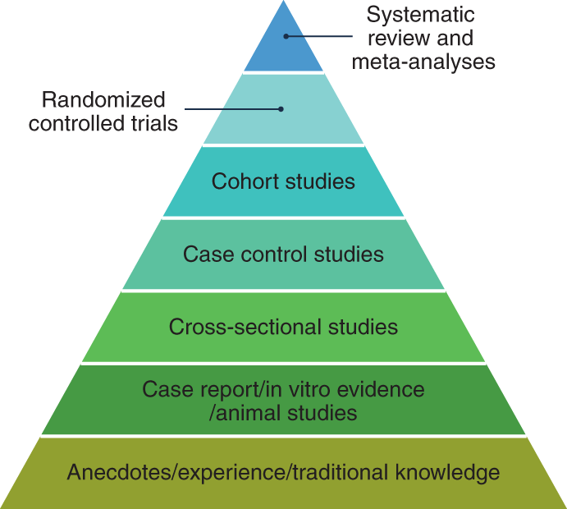
Hierarchy of Evidence
https://www.nature.com/articles/s43016-021-00388-5/figures/1
Dr Jay K Varma | https://drjayvarma.com

Slide 3
Definitions
Systematic Review: Use of explicit, standardized methods to identify, select, and critically appraise research, and to collect and analyze data from the studies identified by the review
Meta-analysis: Use of statistical methods to integrate results of studies identified by the systematic review to make a quantitative assessment of a test, treatment, or other health intervention
Dr Jay K Varma | https://drjayvarma.com

Slide 4
Definitions
You can do a systematic review without doing a meta-analysis
Insufficient data
Insufficient quality of data or quality studies
Not relevant to the question
You should not do a meta-analysis without doing a systematic review
Tools for synthesizing knowledge to improve policy or practice
Dr Jay K Varma | https://drjayvarma.com

Slide 5
Example of Why These Are Important
On Sept 30, 2004, Merck announced withdrawal of rofecoxib (Vioxx) because of increased cardiovascular risk in patients taking drug for >18 months
Decision based on 3-year results of an (unpublished) RCT of rofecoxib for preventing colorectal polyps
By 2004, rofecoxib had been taken by ~ 80 million people and generated ~$2.5 billion in sales
Dr Jay K Varma | https://drjayvarma.com

Slide 6

Dr Jay K Varma | https://drjayvarma.com

Slide 7
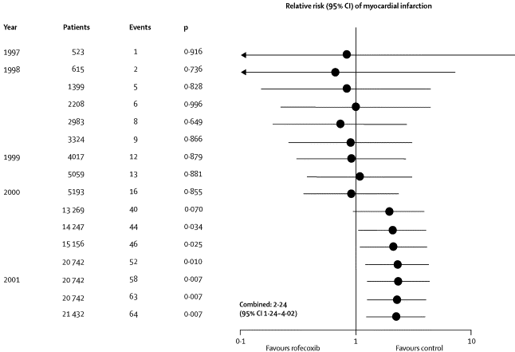
Dr Jay K Varma | https://drjayvarma.com

Slide 8
Our findings indicate that rofecoxib should have been withdrawn several years earlier.
The reasons why manufacturer and drug licensing authorities did not continuously monitor and summarize the accumulating evidence need to be clarified.
Dr Jay K Varma | https://drjayvarma.com

Slide 9
SYSTEMATIC REVIEWS
Dr Jay K Varma | https://drjayvarma.com

Slide 10
Optimum Review
Well-defined research question
Standardized approach, i.e., strict protocol
Comprehensive literature search
Free of bias (publication bias, language bias)
Documentation of all methods for searching and deciding what to include
Up-to-date as possible
Dr Jay K Varma | https://drjayvarma.com

Slide 11
Define Your Research Question Well
Population: the population to whom recommendation applies
Intervention: the medication, vaccine, test, or action you will perform on the population
Comparison: the alternative interventions, including doing nothing
Outcome: beneficial outcomes (e.g., survival) and harmful outcomes
Dr Jay K Varma | https://drjayvarma.com

Slide 12
Electronic Databases: PubMed/Medline
Includes millions of citations and abstracts from more than 4000 journals back to 1948
Updated weekly
Biased toward US journals
Dr Jay K Varma | https://drjayvarma.com

Slide 13
Electronic Databases: Embase
Biomedical and pharmacological database
>20 million records, >7000 journals, back to 1947
Strong coverage of drug literature
Overlap with Medline averages 34% but can vary
More global coverage than PubMed/Medline
Dr Jay K Varma | https://drjayvarma.com

Slide 14
Electronic Databases: Cochrane Review
Cochrane Database of Systematic Reviews
Contains more than 4000 systematic reviews and more than 1900 protocols
Founded in 1993 and named in honor of Archie Cochrane, who wrote in 1979, "It is surely a great criticism of our profession that we have not organized a critical summary, by specialty or subspecialty, adapted periodically, of all relevant randomized controlled trials”
Dr Jay K Varma | https://drjayvarma.com

Slide 15

Electronic Databases: Cochrane Review
Dr Jay K Varma | https://drjayvarma.com

Slide 16
Expand to Include Other Data Sources
Reference lists of included studies
References lists of earlier reviews, commentaries
CDSR, DARE, PubMed search with filters for systematic reviews
Personal communication with experts and authors
Contacting drug/device companies
Dr Jay K Varma | https://drjayvarma.com

Slide 17
Expand to Include Other Data Sources
Handsearching of key, high-yield journals
Grey literature
Dissertation abstracts, reports, conference proceedings, etc.
Sources of ongoing trials
Trial registers, drug companies, contacting experts
Dr Jay K Varma | https://drjayvarma.com

Slide 18
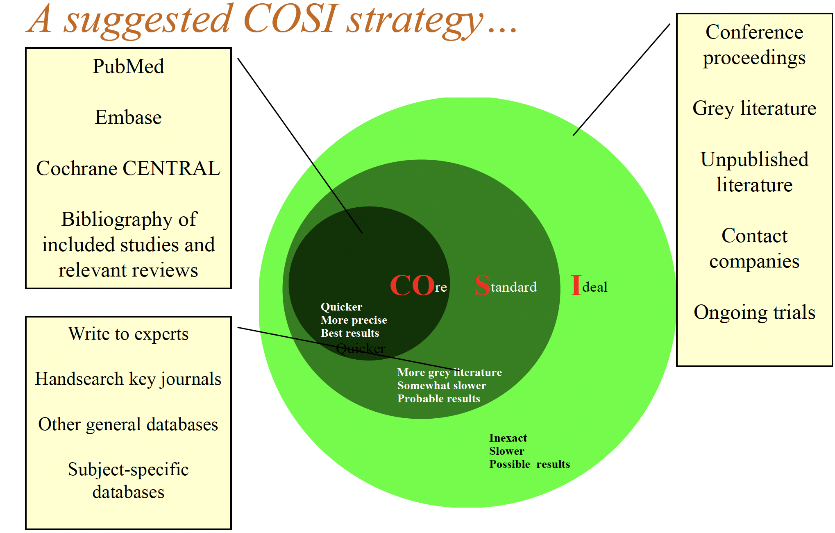
Figure courtesy of Madhu Pai, PhD
Dr Jay K Varma | https://drjayvarma.com

Slide 19
Managing and Documenting Search
Use reference software
Reference Manager, EndNote, Zotero
Document all articles you found, where you found them, whether you excluded them and why
Involve a librarian!
Dr Jay K Varma | https://drjayvarma.com

Slide 20
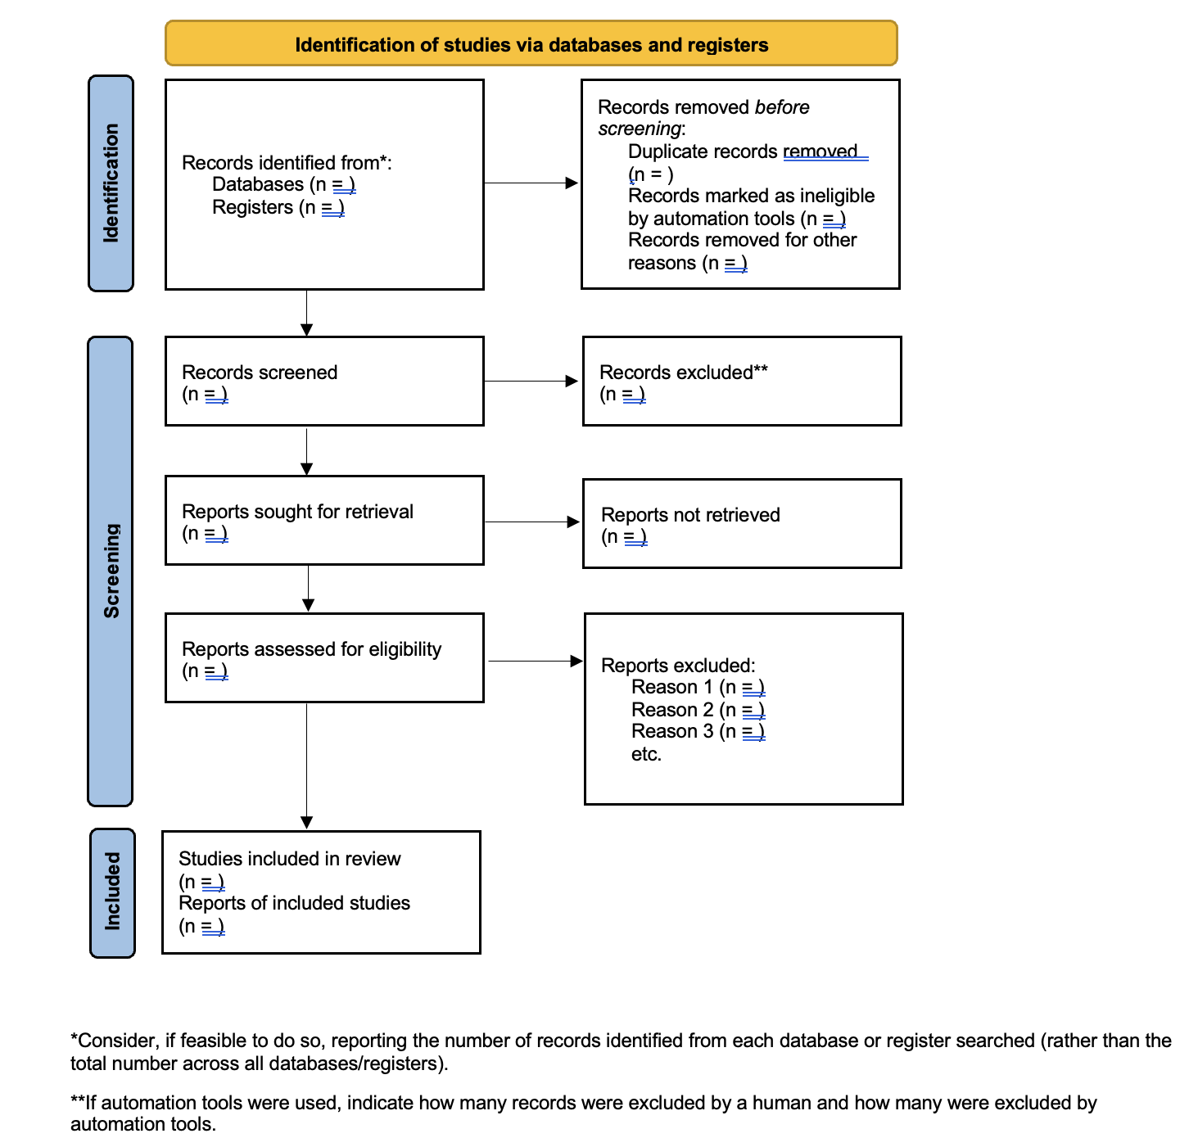
Page MJ, et al. The PRISMA 2020 statement: an updated guideline for reporting systematic reviews. BMJ 2021;372:n71. doi: 10.1136/bmj.n71
Dr Jay K Varma | https://drjayvarma.com

Slide 21
Overview
Develop a focused research question
Define inclusion/exclusion criteria
Select the outcomes for your review
Find the studies
Abstract the data
Assess quality of the data
Dr Jay K Varma | https://drjayvarma.com

Slide 22
Overview
Synthesize the data descriptively and inferentially via meta-analysis if appropriate
Summarize the findings
Dr Jay K Varma | https://drjayvarma.com

Slide 23
META-ANALYSIS
Dr Jay K Varma | https://drjayvarma.com

Slide 24
Methods – The Bare Basics
Statistical combination of results from > 2 studies
Most meta-analyses use a weighted average of the effect estimates from the different studies
Many judgements made about what outcome to choose, how to manage missing data, how to manage differences in study designs
Sensitivity analyses often performed to ensure results are valid
Dr Jay K Varma | https://drjayvarma.com

Slide 25
Methods – Stage 1
Pick an outcome that applies to every study in your systematic review (e.g., death, blood pressure)
Calculate the “effect estimate” for that outcome for each study in your systematic review
Called “summary statistic”
Dr Jay K Varma | https://drjayvarma.com

Slide 26
Methods – Stage 2
Calculate a summary (combined) effect estimate
A weighted average of the intervention effects estimated in the individual studies
Each study given a different “weight” depending on size, quality, or other factors
Dr Jay K Varma | https://drjayvarma.com

Slide 27
Methods – Stage 2
Statistical methods to account for differences in studies (“heterogeneity”)
“random effects model” = each study estimates the outcome differently because of differences in methods, population, or some other issue
“fixed effects model” = each study estimates the exact same quantity/outcome in a similar way
Dr Jay K Varma | https://drjayvarma.com

Slide 28
Forest Plot
A way to show the results of the analysis
Show an effect estimate and confidence interval for each study and for all studies combined
Each study represented by a block along a line
The size of the block is bigger for studies with larger sample sizes (more weight), drawing the eye to those studies that have the biggest impact on the final meta-analysis results
Dr Jay K Varma | https://drjayvarma.com

Slide 29
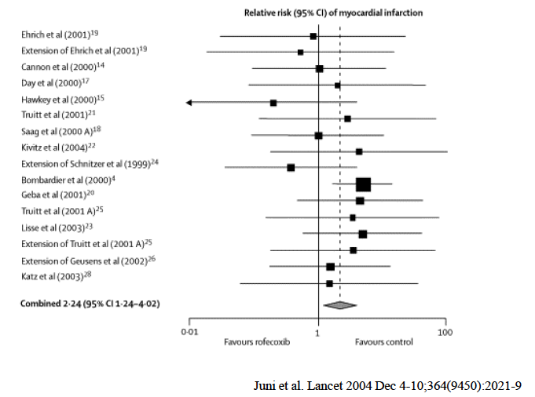
Dr Jay K Varma | https://drjayvarma.com

Slide 30
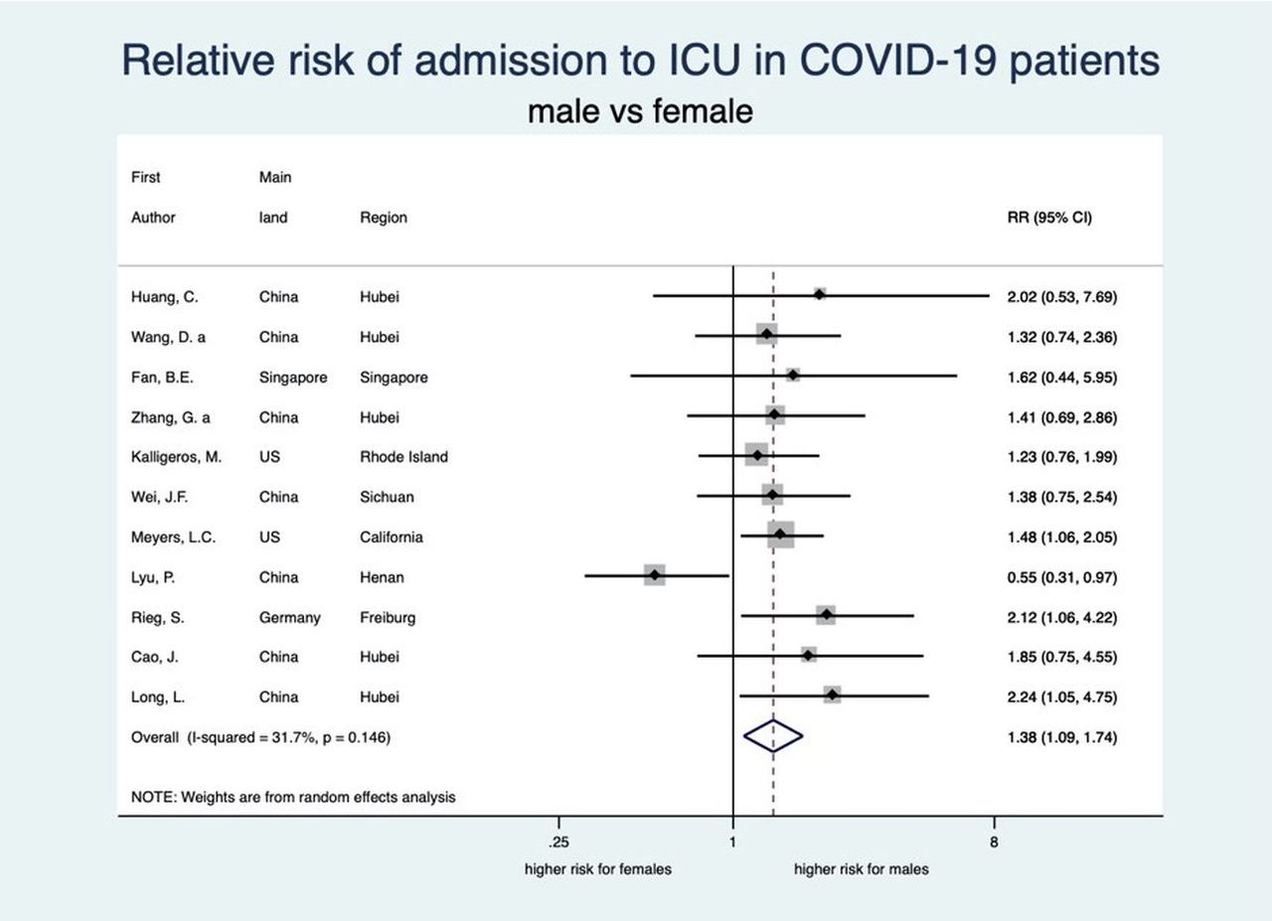
Pijls, et. al, http://dx.doi.org/10.1136/bmjopen-2020-044640
Dr Jay K Varma | https://drjayvarma.com

Slide 31
Challenge of “Heterogeneity”
Variation in results between studies
Could be due to random chance if all studies conducted identically
More often due to differences in study population, design, or analysis methods
Dr Jay K Varma | https://drjayvarma.com

Slide 32
Challenge of “Heterogeneity”
Forest plot
Do confidence intervals for studies NOT overlap?
Calculate I² (“I squared”)
Ranges ranging from 0-100%,
Greater the I² = more heterogeneity.
I² < 40% likely studies similar
I² > 75% studies very dissimilar (heterogeneous)
Dr Jay K Varma | https://drjayvarma.com

Slide 33
A Meta-Analysis May Mislead
Review not systematic, eg, missing important studies
Review includes low quality studies, eg, those that are small and inconclusive
Review does not adjust for study quality
Methods of combining results flawed
Publication bias (to be discussed in future lecture)
Dr Jay K Varma | https://drjayvarma.com

